Slide 1

Assembly issues for DVT3 3D data

Slide 2
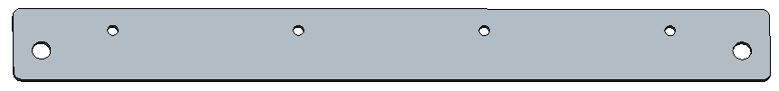

SPONGE_MIC_SILICON_140X24 and HOLDER MIC are still old and have not been updated.
SPONGE_MIC_SILICON_140X24
HOLDER MIC
[ALT]
Will update modeling data
- SPONGE_MIC_SILICON_140X24 : Need to test result.=
-HOLDER MIC : apply this data

Slide 3
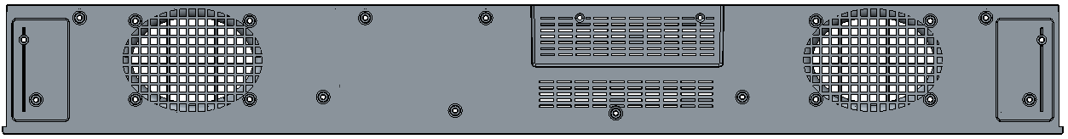
The hole at the bottom of the bottom cover is not helpful for thermal result.
So please to sealing the venting holes, it can also solve the ESD issue.
[ALT]
Vent hole ready for thermal.
We will review DVT3 housing thermal test and decision keep or remove vent hole. (like T0 / T1)

Slide 4
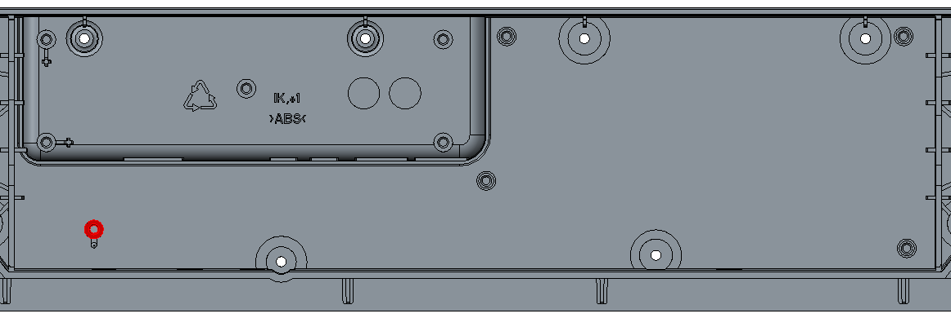
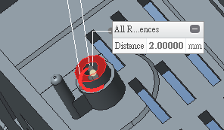
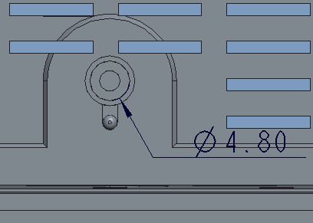
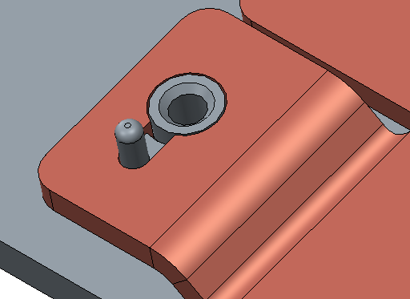
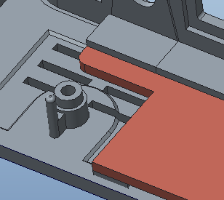
Heat spreader for DVT3 build
Need to be addedd by 2mm on screw hole
Heat spreader for DVT1 & 2 build
[ALT]
OK.
Will update screw hole.
Please add 2mm on screw hole, so that we can also assembly the SoC board with DVT1 heat spreader samples.

Slide 5
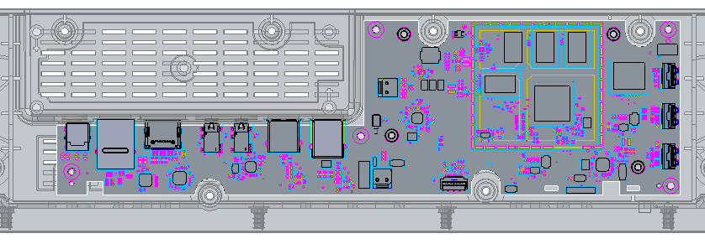
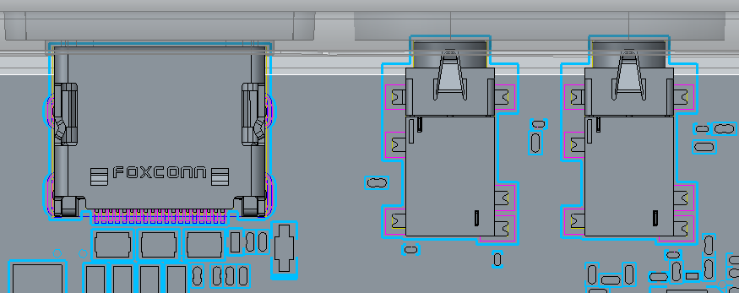
The I/O connector will interfere with bottom cover respectively when assembled
[ALT]
We tested SKB standard HDMI / MIC jack.
DVT unit has issue for not HDMI / MIC jack not fully insert.
It may be a little more difficult to assemble than DVT1, but it will be possible.
Please update the assembly issue on DVT3

Slide 6
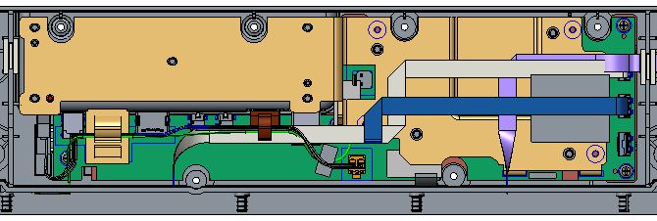
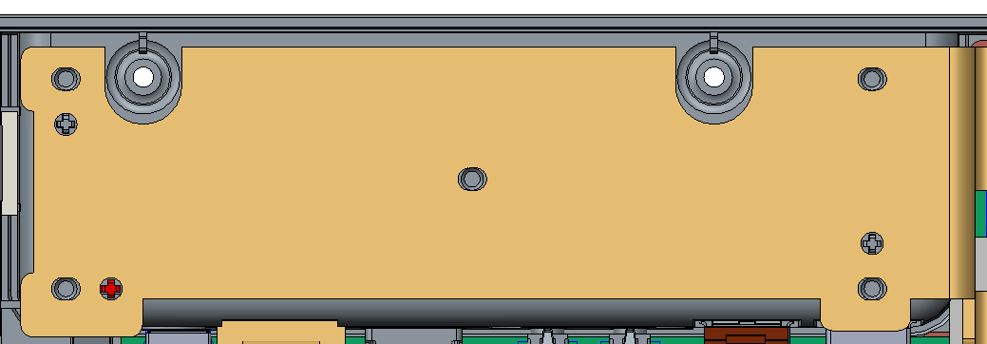
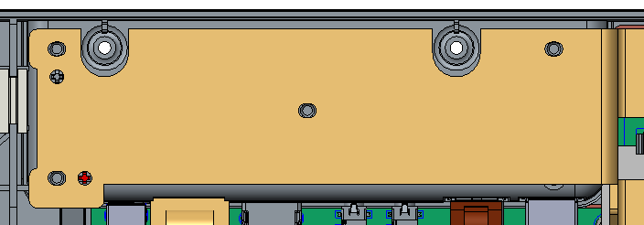
DVT3 3D data
DVT1 heat spreader
[ALT]
OK. Will update as suggestion
Please add the fix-boss on the left side, so that we can also use DVT1’s heat spreader samples.

Slide 7
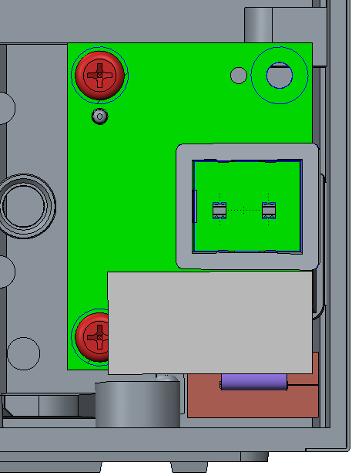
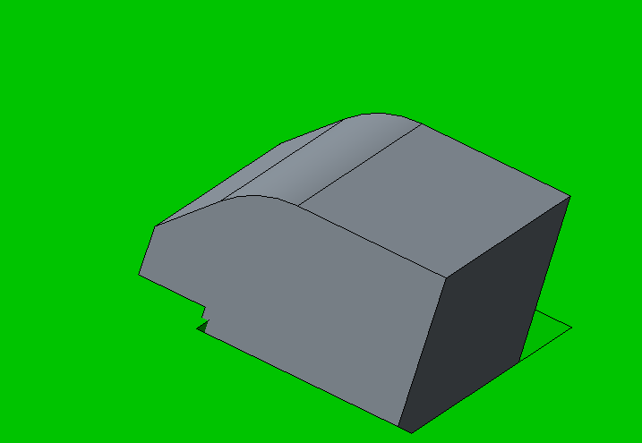
GLUE AREA
[ALT]
That is assembly gap : 0.1mm
And interfere
: Design intent to be tight using the elasticity of the bracket
In a normal sound bar manufacturing, In a structure like this, the glue cannot be removed. Due to vibration issue
Suggestion
: if you want to remove glue process, please modify to reduce PCB hole size and verify
Please change the light pipe to interfere with side LED PCB for the vibration issue. So that we don’t have to add glue between LED light pipe and side LED PCB.

Slide 8
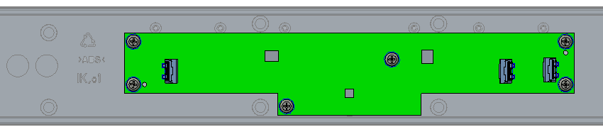
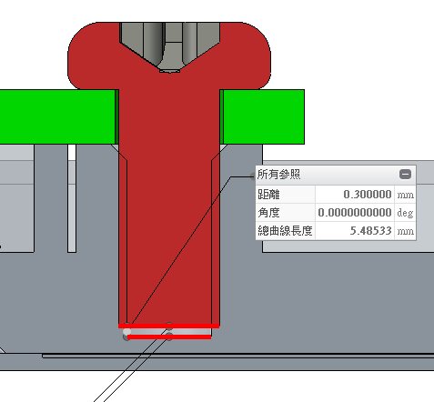
Please check whether the GRILL FABRIC ASS'Y will be damaged by screw.
[ALT]
3X7 screw is OK. Use screws with good size control
Also 3X5 or 3X6 is Ok to use, but need to verify FXN self.

